Slide 1
OBJ to binary structure
File structure
V1.0
G. Dumitra

Slide 2
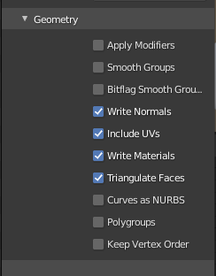
How to export from Blender to OBJ
In order to have the OBJ and MTL files compatible with this parser you need to export from Blender with the triangulate faces option check!

Slide 3
Obj name
<array of signed chars>
No of chars <signed int>
No of triangles/faces units <signed int>
X,Y,Z coordinates
Array of float [3]
“is U,V ?” Bool 0 or 1 <byte>
Only if “U,V” value=1 →
U,V coordinates(*)
Array of float [2]
“is Normal?” Bool 0 or 1 <byte>
Only if “is Normal” value=1 →
X,Y,Z normal
Array of float [3]
X,Y,Z coordinates
Array of float [3]
“is U,V ?” Bool 0 or 1 <byte>
Only if “U,V” value=1 →
U,V coordinates(*)
Array of float [2]
“is Normal?” Bool 0 or 1 <byte>
Only if “is Normal” value=1 →
X,Y,Z normal
Array of float [3]
Obj name
<array of signed chars>
No of chars <short>

Slide 4


Example:
Obj name
<array of signed chars>
No of chars <short>
6 characters (including NULL termination)
The 5+1 characters are “ju-87”
No of triangles units (green) <signed short>
The “ju-87” object has 5706 triangles

